Slide 1

09 MARCH 2021 by Muhammad azizi Mohd ariffin
INTERNET OF THINGS (IOT) TUTORIAL FOR BEGINNERS

Slide 2
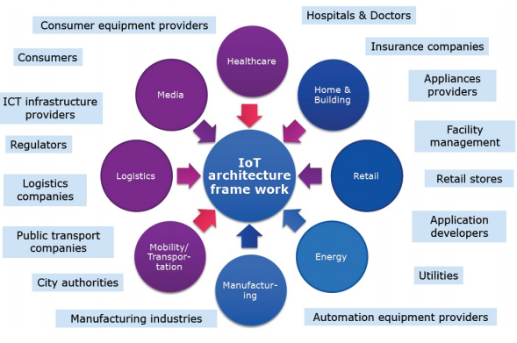
Introduction to iot
IEEE Definition:
“A network of items, each embedded with sensors, which are connected to the Internet.”

Slide 3
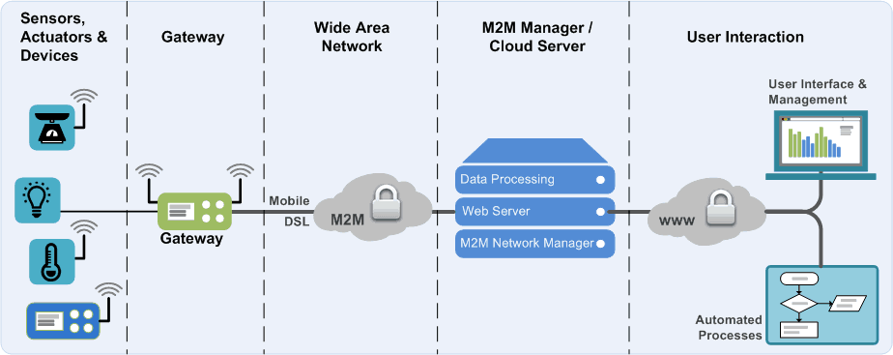
Iot Architecture
IP
Wi-Fi/Lora WAN
Firebase
Blynk / Things Speak Platform
Digital Ocean / Amazon AWS
DHT11
DHT22
CO2 Sensor
Motion Sensor
Arduino UNO Node MCU ESP8266/ESP32
Raspberry PI
Grafana Laravel PHP/MYSQL

Slide 4
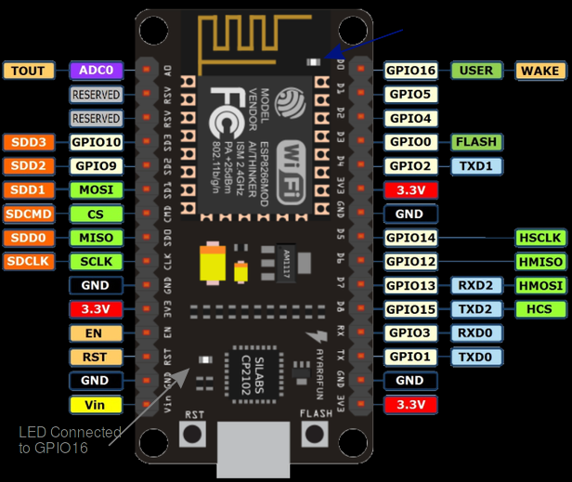
IOT hardware (Microcontroller)
NodeMCU ESP8266

Slide 5
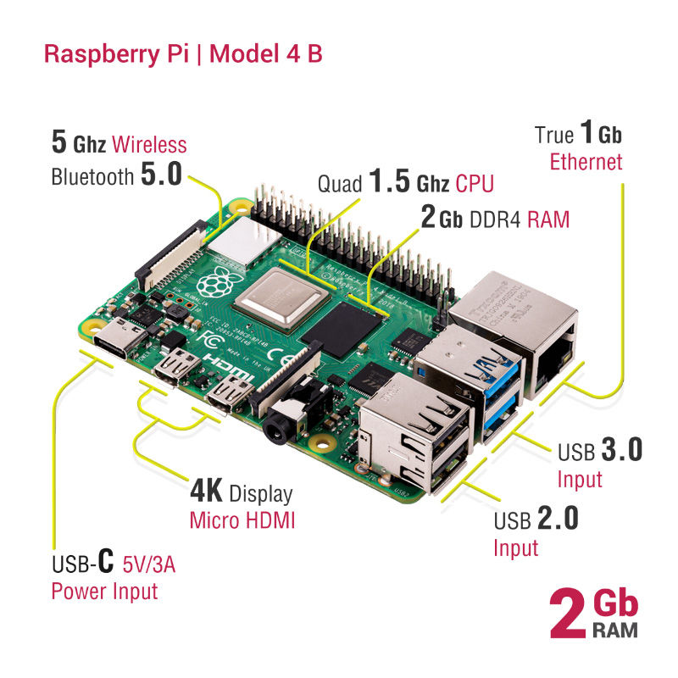
IOT hardware (Single-board computer)
Raspberry PI

Slide 6
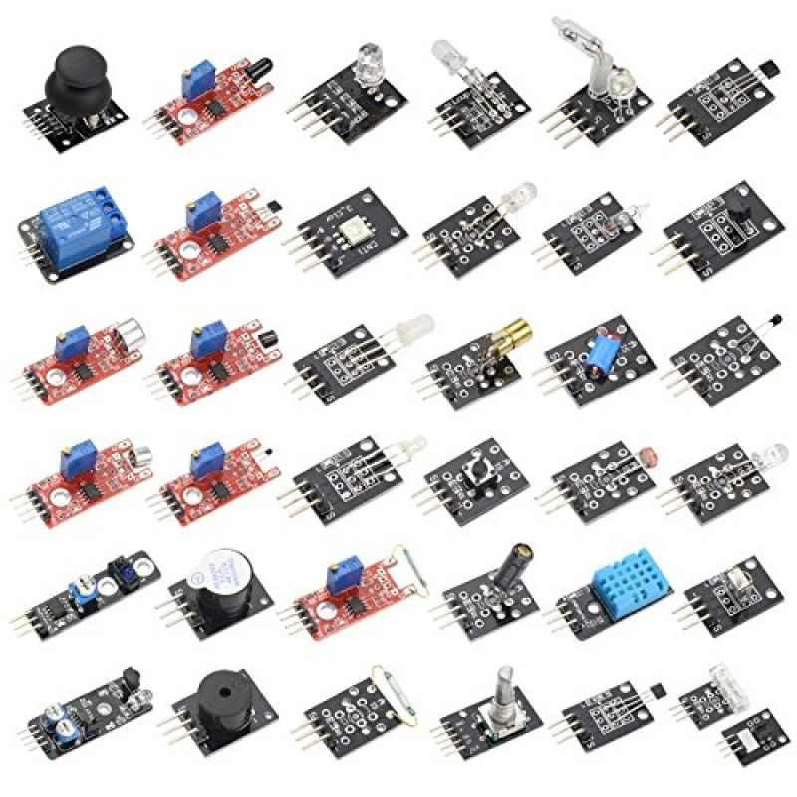
IOT hardware (Sensors)
DHT11 & 22 (Temperature & Humidity)
Soil Moisture Sensor
CO2 Sensor
PH Sensor
Motion Sensor

Slide 7
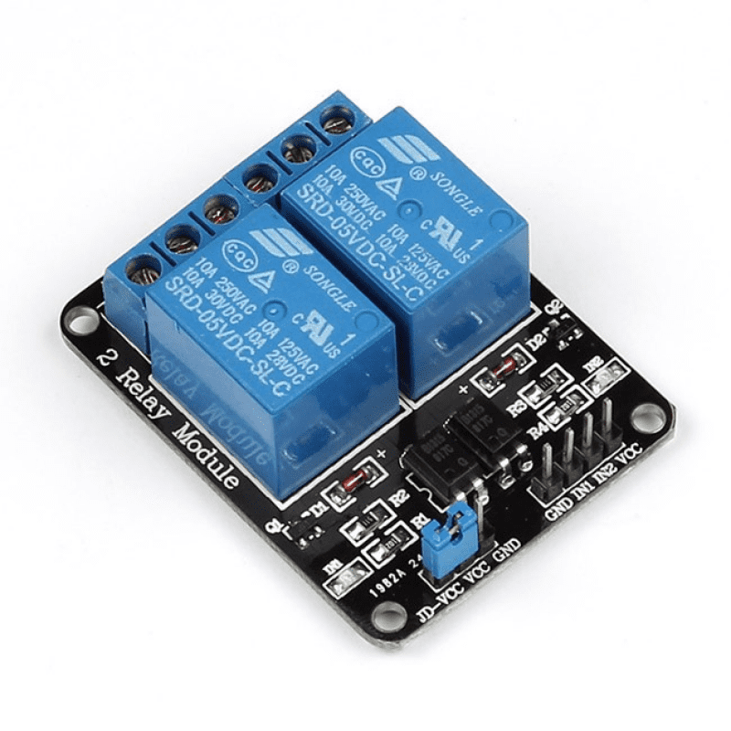
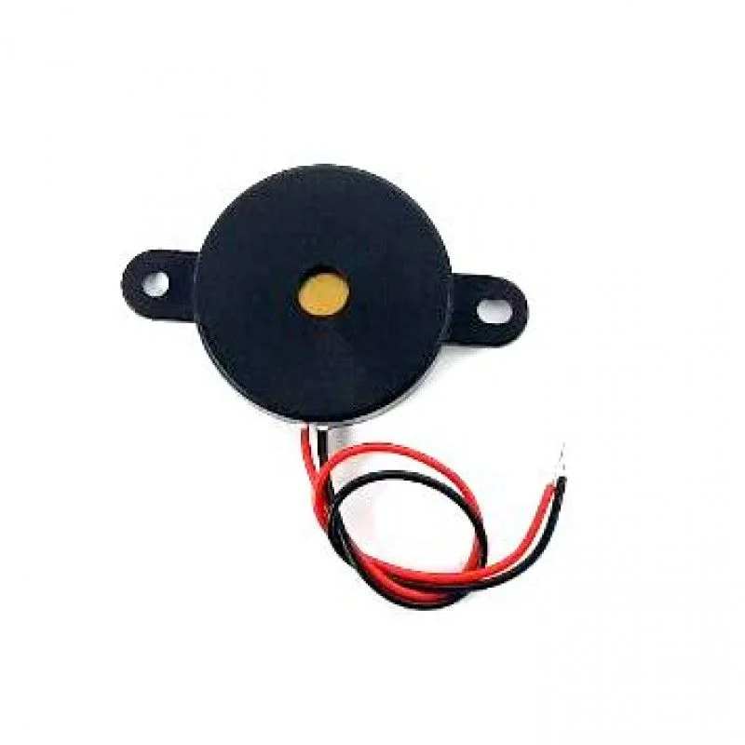
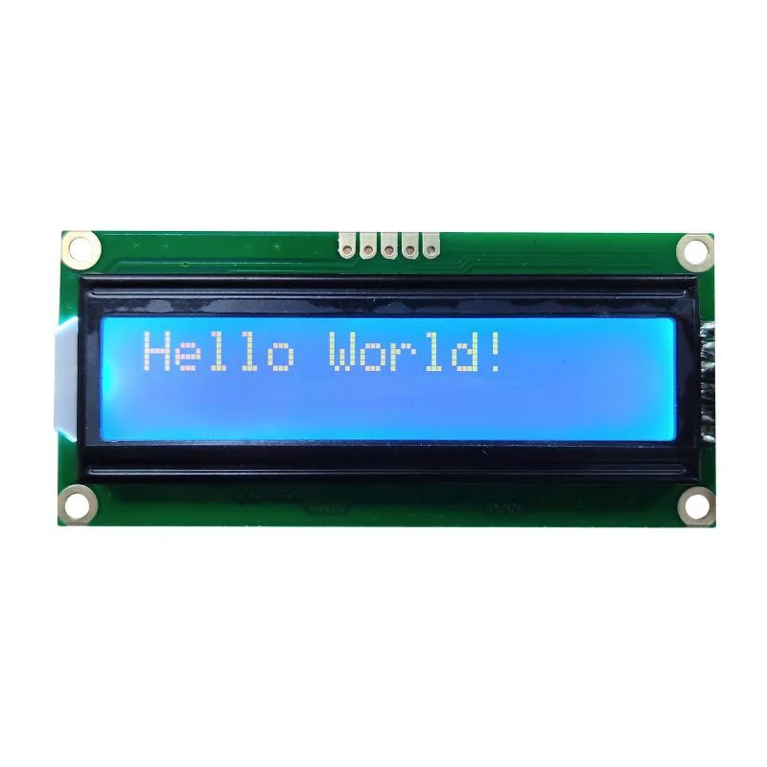
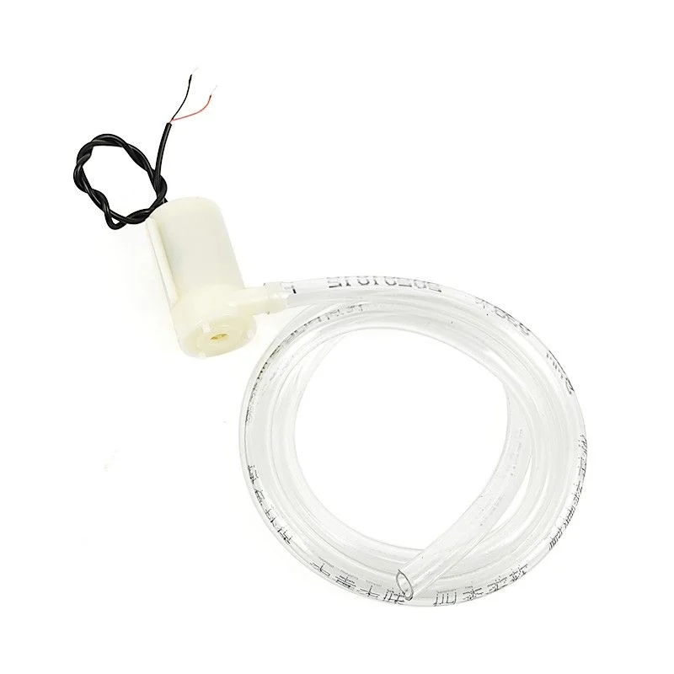
IOT hardware
Relay
Buzzer
Water Pump
LCD Display

Slide 8
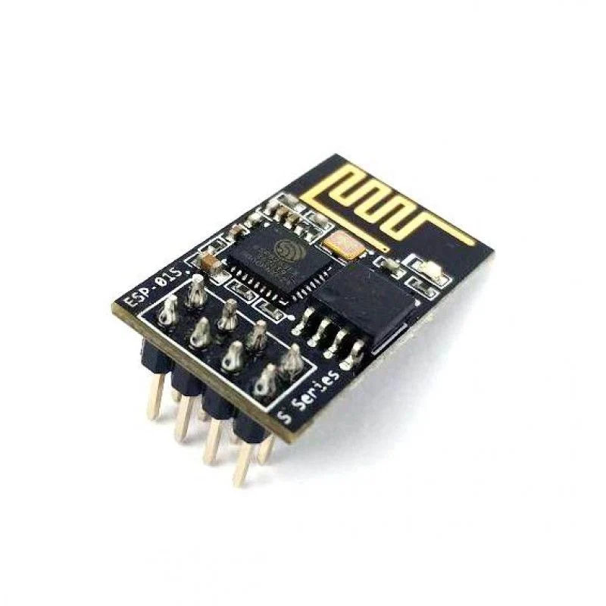
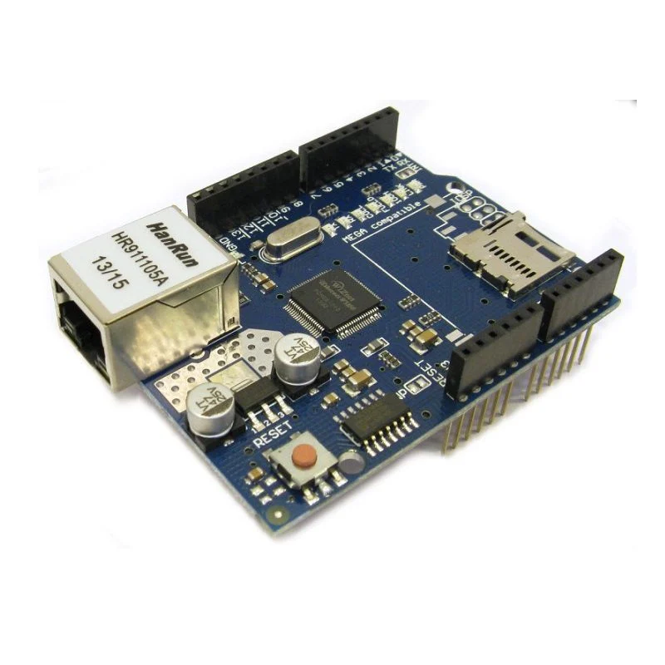
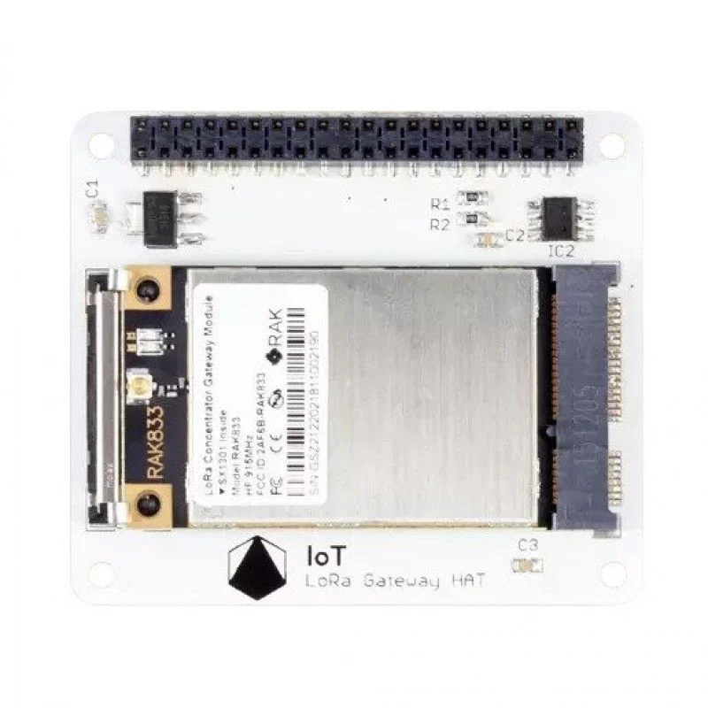
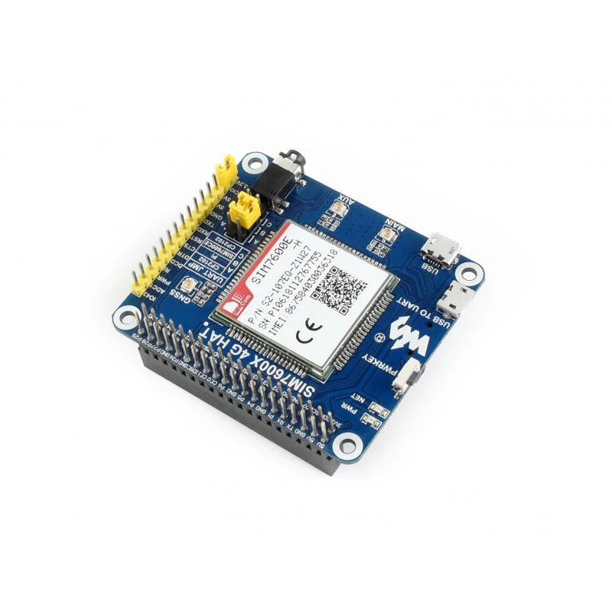
IOT hardware (Connectivity)
Wi-Fi
Ethernet
LoraWAN
Bluetooth
Zigbee
GSM

Slide 9
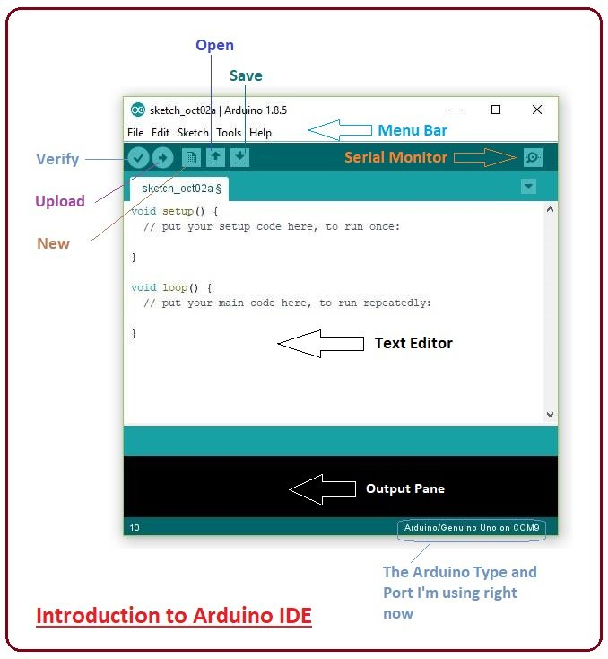
IOT Software
Arduino IDE
IBM NodeRED
MicroPython
Blynk Smartphone App

Slide 10
IOT exercise
Activity 1: Installing Arduino IDE & Connecting Sensors to Arduino
Activity 2: Displaying Sensor value via HTTP Web Server
Activity 3: Network Socket in Arduino
Activity 4: Pushing Sensor data to MYSQL Server
@Firebase
Activity 5: Pushing sensor data to Blynk Platform

Slide 11
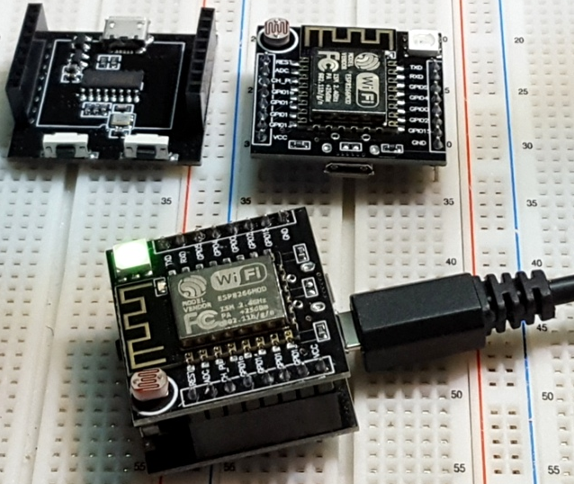
Thank you let's get our hands dirty

